Slide 1
Employee Data Analysis using Excel
STUDENT NAME : Vennila.M
REGISTER NO :312214968
DEPARTMENT : Commerce
COLLEGE : Annai veilakanni’s for women college

Slide 2
PROJECT TITLE
Employee Performance Analysis using Excel

Slide 3


AGENDA
Problem Statement
Project Overview
End Users
Our Solution and Proposition
Dataset Description
Modelling Approach
Results and Discussion
Conclusion
3/21/2024 Annual Review

Slide 4

PROBLEM STATEMENT
Accurately evaluate employee performance
Idntify strengths, weaknesses, opportunities and threats(SWOT analysis)
Develop targeted interventions and training programs
Inform talent management decisions (promotions,successions)

Slide 5

PROJECT OVERVIEW
Analysis employee performance data to identify key drivers of performance and areas for improvement
Develop data- driven insights to inform talent management decisions,training programs and leadership development initiatives
Focus on identifying key predictors of performance , area of improvement and opportunities for growth and development

Slide 6

WHO ARE THE END USERS?
Line managers
HR business partners
Senior leadership
Employee development teams
Compensation and benefits teams
Talent acquisition teams
Employees
Organizational development teams

Slide 7

OUR SOLUTION AND ITS VALUE PROPOSITION
Solution : Empower AI – employee performance insights.
Value proportion:
Identify top performers
Pinpoint skill gaps
Enhance employee engagement
Inform data – driven decisions
Boost productivity

Slide 8
Dataset Description
Description : This data set contains information on employee performance ,demographics ,and development activities
Fields:
Employee ID
Name
Job role
Department
Performance rating
Performance level

Slide 9

THE "WOW" IN OUR SOLUTION
AI driven predictive analytics for accurate forecasting and insights
Automated performance scoring for unbiased evaluations
Personalized development plans for targeted growth and improvement
Real-time feedback and coaching for continuous development
Intuitive and interactive dashboards for easy visualization and tracking
3/21/2024 Annual Review
9

Slide 10
MODELLING
Regression Analysis
Decision Trees
Clustering Analysis
Predictive Modeling
Propensity Scoring
Survival Analysis
Network Analysis
Machine Learning Algorithms
Simulation Modeling
Bayesian Networks
10

Slide 11
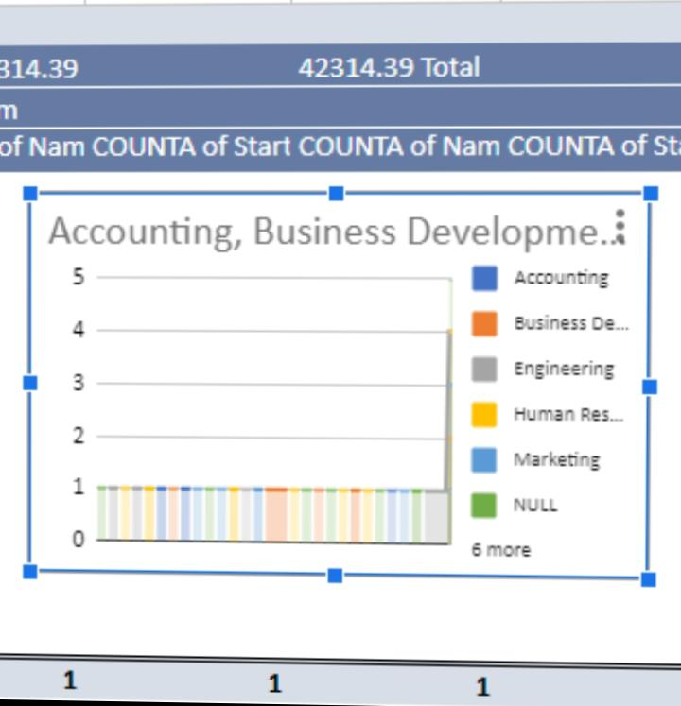
RESULTS
11

Slide 12
conclusion
Employee performance analysis is a critical component of talent management, enabling organizations to make data driven decisions ,drive business outputs and enhance employee experience. By leveraging advanced analytics modelling techniques.

